Slide 1

MAULANA AZAD NATIONAL URDU UNIVERSITY
(A Centarl University Established By An Act Of Parliament In 1998)
(DEPARTMENT OF CS & IT)

Slide 2
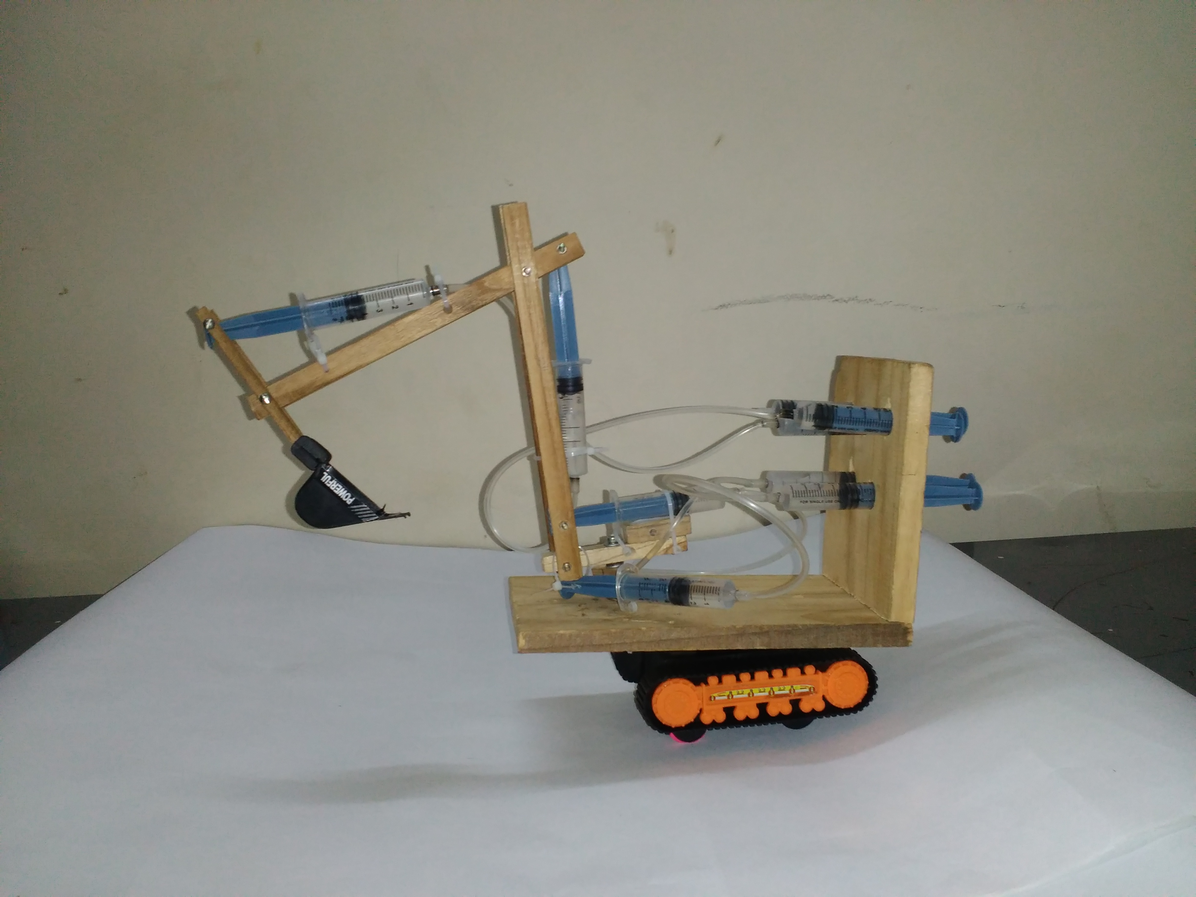
PROJECT PERSENTATION TOPIC--- (HYDEROLIC MACHIN)
PERSENTED
1.MD MOZAMMIL ANWAR COURSE-B.TECH YEAR-1ST ROLL-1407010417 DEPT-CS&IT REG ID-TT343
UNDER GUIDE--------
Asst.prof(manuu)
Dept.(Cs&It)
MOHD.RAFEEQ

Slide 3
Hydraulics:-----
1.About.
2.Introduction.
3.Principal.
4.Working Function.
5.Types.
6.Uses.
7.Advantage.
8.disadvantage.
9.Conclusion

Slide 4
HYDRAULIC:
HYDRo
AULUS
Hydraulic word came from FRENCH LANGUAGE
-HYDRO MEANS (WATER)
-AULUS MEANS (PIPE)

Slide 5
INTRODUCTION:-
“Fluids used in mobile & stationary
machinery must be effective in the
transmission of power from the source to
provide consistent and reliable response ,
safe operation ,and optimum efficiency

Slide 6
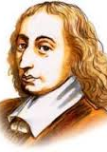
PRINCIPAL:-
It is work on the Pascal's law
Pascal's law: The change in pressure
at any point in an enclosed fluid at
rest is transmitted undiminished to all
in fluid.
This is the basic principal behind any
hydraulic system pressure applied
anywhere to a body of transmitted
equally in all direction with the force
acting at right angle to any surface in
contact with the fluid.

Slide 7
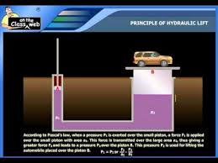
WORKING FUNCTION:
When we push (close pipe
filed by liquid ) then other side
of pipe is pulled automatically
this is actually effect of
pressure ,force.

Slide 8
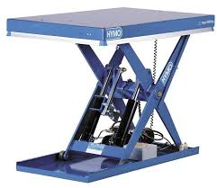
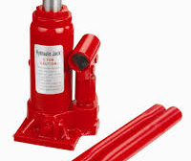
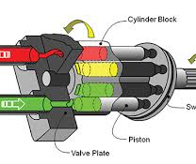
Types of hydraulic :
Hydraulic lift
Hydraulic pump
Hydraulic jack
For lifting purpose
For carry load
For jacking

Slide 9
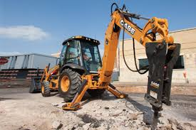
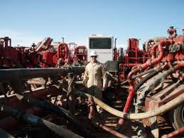
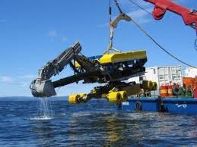
USES OF HYDRAULICS:
In construction
In industry
I n marine
-for drilling.
-for loading.
-for soil cutting. Etc.
-for load slide.
-for load put.
-for load exert
-for machinery
part .and many more.

Slide 10
ADVANTAGE :
It can do our work easily
It will save our time
It can work fastly
It can save our money during long project
It is easily available in market
It is also source of income
It deliver consistent power out put

Slide 11
Limitation:
It can not be use in more sludge area
It is commercially high

Slide 12
CONCLUSION:
Over all this is very good for us
Because it help us in time save
It decrease the Requirement of more employee
we can complete our work in low cost
It has a lot of used in(maximum) industries

Slide 13


